Slide 1

DEPENDENCY INJECTION & DESIGN PATTERNS

Slide 2
AGENDA
What is a dependency?
Types of dependencies
DI antipatern
Inversion of control
Dependency injection
Design patterns

Slide 3
1.What is a dependency?
Introduces a level of coupling in your code
Sometimes your code becomes resistant to change
You can’t test anything in isolation
You can’t reuse code
Code readability - bad
Bigger code source
Low code quality

Slide 4
2.Types of dependencies
Visible
public class CustomerAccount
{
private BankAccount currentAccount;
public CustomerAccount(BankAccount currentAccount)
{
this.currentAccount = currentAccount;
}
}
Are a set of rules that enable developers to write software that is easily extendable, maintainable, easy to read and easy to adapt to changing requirements.
Are a set of rules that enable developers to write software that is easily extendable, maintainable, easy to read and easy to adapt to changing requirements.

Slide 5
2.Types of dependencies
Hidden
public class SurvivalAccount
{
private IBankAccount shoesAccount;
private IBankAccount handBagsAccount;
public SurvivalAccount()
{
this.shoesAccount = new ShoesAccount();
this.handBagsAccount = new HandBagsAccount();
}
}
Are a set of rules that enable developers to write software that is easily extendable, maintainable, easy to read and easy to adapt to changing requirements.
Are a set of rules that enable developers to write software that is easily extendable, maintainable, easy to read and easy to adapt to changing requirements.

Slide 6
2.Types of dependencies
Volatile
Require setup or a configuration
Implementation of dependency hasn’t been created yet.
Can be a third party library that requires a license.
Have non-deterministic behavior => can’t be tested
Looked at from the environment perspective
Are a set of rules that enable developers to write software that is easily extendable, maintainable, easy to read and easy to adapt to changing requirements.
Are a set of rules that enable developers to write software that is easily extendable, maintainable, easy to read and easy to adapt to changing requirements.

Slide 7
Tight coupling
public class BankAccount
{
private SavingsAccount savingsAccount = new SavingsAccount();
private CurrentAccount currentAccount = new CurrentAccount();
public decimal GetTotalForAccount(Guid accountNumber)
{
decimal currentAccountMoney = this.currentAccount.GetMoneyByAccountNumber(accountNumber);
decimal savingsAccountMoney = this.savingsAccount.GetMoneyByAccountNumber(accountNumber);
return currentAccountMoney + savingsAccountMoney;
}
}
Are a set of rules that enable developers to write software that is easily extendable, maintainable, easy to read and easy to adapt to changing requirements.
Are a set of rules that enable developers to write software that is easily extendable, maintainable, easy to read and easy to adapt to changing requirements.

Slide 8
Loose coupling
public class BankAccount
{
private IBankAccount currentAccount;
private IBankAccount savingsAccount;
public BankAccount (IBankAccount currentAccount, IBankAccount savingsAccount)
{
this.currentAccount = currentAccount;
this.savingsAccount = savingsAccount;
}
}
Are a set of rules that enable developers to write software that is easily extendable, maintainable, easy to read and easy to adapt to changing requirements.
Are a set of rules that enable developers to write software that is easily extendable, maintainable, easy to read and easy to adapt to changing requirements.
Loose coupling is achieved through interfaces because you can inject any implementation you want!

Slide 9
Another bad one
public class BankAccount
{
private BankAccount currentAccount;
private BankAccount savingsAccount;
public BankAccount (BankAccount currentAccount, BankAccount savingsAccount)
{
this.currentAccount = currentAccount;
this.savingsAccount = savingsAccount;
}
}
Are a set of rules that enable developers to write software that is easily extendable, maintainable, easy to read and easy to adapt to changing requirements.
Are a set of rules that enable developers to write software that is easily extendable, maintainable, easy to read and easy to adapt to changing requirements.

Slide 10
Better way
public class BankAccount
{
private IBankAccount currentAccount;
private IBankAccount savingsAccount;
public BankAccount (IBankAccount currentAccount, IBankAccount savingsAccount)
{
this.currentAccount = currentAccount;
this.savingsAccount = savingsAccount;
}
}
Are a set of rules that enable developers to write software that is easily extendable, maintainable, easy to read and easy to adapt to changing requirements.
Are a set of rules that enable developers to write software that is easily extendable, maintainable, easy to read and easy to adapt to changing requirements.

Slide 11
3.DI antipatern
Most common DI – antipattern
Default way of creating instances
No effort to introduce abstractions
We can’t change implementations
We can’t develop in parallel
The Most Problematic in terms of coupling
Every time when directly or indirectly use the new keyword !
Are a set of rules that enable developers to write software that is easily extendable, maintainable, easy to read and easy to adapt to changing requirements.
Are a set of rules that enable developers to write software that is easily extendable, maintainable, easy to read and easy to adapt to changing requirements.

Slide 12
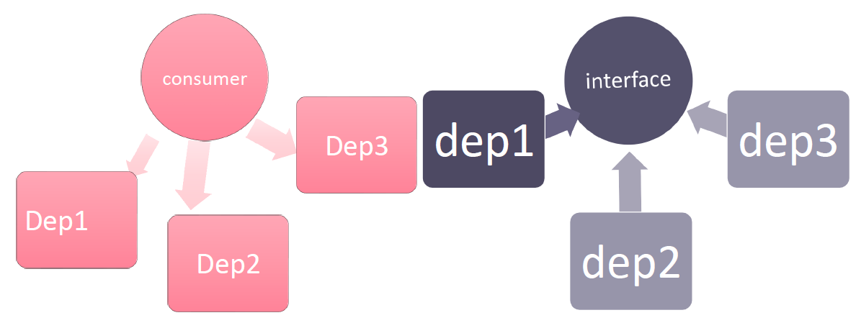
4. Inversion of control
Programming style where a framework or runtime controls the program flow
You let a framework to take care of instance creation
You move somewhere else the decisions of which concrete class to use
Are a set of rules that enable developers to write software that is easily extendable, maintainable, easy to read and easy to adapt to changing requirements.
Are a set of rules that enable developers to write software that is easily extendable, maintainable, easy to read and easy to adapt to changing requirements.

Slide 13
5. Dependency injection
Subset of Inversion of Control
Refers to dependency management
The idea is to have a mechanism that provides concrete implementation over an abstraction
Helps with Single Responsibility (SR) and Separation of Concerns (SoC).
Are a set of rules that enable developers to write software that is easily extendable, maintainable, easy to read and easy to adapt to changing requirements.
Are a set of rules that enable developers to write software that is easily extendable, maintainable, easy to read and easy to adapt to changing requirements.
Why?
Loose coupling (Extensibility, Testability, Reusability)
DRY – write less boiler plate code
Mockability (yes, that’s a word)
You don’t pull your dependencies, they are pushed
The mindset
It’s not a goal
It’s one of the best ways to enable loose coupling
If used right, gives you more maintainable code
It’s more a way of thinking and designing code than a collection of tools and techniques
Not the supreme approach, but should be the norm

Slide 14
Types of injection
Constructor injection (best one, should always be used despite having 2 more options in the bag)
public class CustomerBusinessLogic
{
ICustomerDataAccess _dataAccess;
public CustomerBusinessLogic(ICustomerDataAccess custDataAccess)
{
_dataAccess = custDataAccess;
}
}
Are a set of rules that enable developers to write software that is easily extendable, maintainable, easy to read and easy to adapt to changing requirements.
Are a set of rules that enable developers to write software that is easily extendable, maintainable, easy to read and easy to adapt to changing requirements.

Slide 15
Types of injection
Property injection (bad, should be avoided, antipatern)
public class CustomerBusinessLogic
{
public CustomerBusinessLogic()
{
}
public ICustomerDataAccess DataAccess { get; set; }
public string GetCustomerName(int id)
{
return DataAccess.GetCustomerName(id);
}
}
Are a set of rules that enable developers to write software that is easily extendable, maintainable, easy to read and easy to adapt to changing requirements.
Are a set of rules that enable developers to write software that is easily extendable, maintainable, easy to read and easy to adapt to changing requirements.

Slide 16
Types of injection
Method injection (bad, should be also avoided, antipatern)
public class CustomerBusinessLogic
{
ICustomerDataAccess _dataAccess;
public CustomerBusinessLogic()
{
}
public void SetDependency(ICustomerDataAccess customerDataAccess)
{
_dataAccess = customerDataAccess;
}
public string GetCustomerName(int id)
{
return _dataAccess.GetCustomerName(id);
}
}
Are a set of rules that enable developers to write software that is easily extendable, maintainable, easy to read and easy to adapt to changing requirements.
Are a set of rules that enable developers to write software that is easily extendable, maintainable, easy to read and easy to adapt to changing requirements.

Slide 17
6. Design patterns
A software design pattern is a general, reusable solution to a commonly occurring problem within a giving context in software design.
Strategy
Builder
Are a set of rules that enable developers to write software that is easily extendable, maintainable, easy to read and easy to adapt to changing requirements.
Are a set of rules that enable developers to write software that is easily extendable, maintainable, easy to read and easy to adapt to changing requirements.

Slide 18



Thank you!
Mirel Aioanei
Alina Anton
Mirel.Aioanei@endava.com
Alina.Anton@endava.com

